Slide 1
Linked Lists (Chapter 16) - Q1
What is the primary advantage of a linked list over an array?
A) Fixed size
B) Faster access to elements by index
C) Dynamic size
D) Better memory utilization for sorted data

Slide 2
Linked Lists (Chapter 16) - Q2
Which operation in a linked list involves removing a node and freeing its memory?
A) Traversal
B) Insertion
C) Deletion
D) Sorting

Slide 3
Pointers and Classes (Chapter 12) - Q3
What is a shallow copy in pointer-based classes?
A) It creates a new memory location for copied objects.
B) Both objects share the same memory location.
C) It always throws a runtime error.
D) It prevents memory leaks.

Slide 4
Pointers and Classes (Chapter 12) - Q4
What is the correct use of the '->' operator in pointer variables?
A) Accessing an object's private members
B) Accessing members of an object through a pointer
C) Performing pointer arithmetic
D) Releasing memory occupied by a pointer

Slide 5
Recursion (Chapter 15) - Q5
What is required for a recursive function to terminate?
A) Base case
B) Stack overflow
C) A loop
D) Recursive case

Slide 6
Recursion (Chapter 15) - Q6
Which of the following is a tail-recursive function?
A) A recursive function that calls itself at the beginning.
B) A recursive function where the recursive call is the last operation.
C) A recursive function that does not return a value.
D) A recursive function that uses global variables.

Slide 7
Sorting Algorithms - Q7
What is the time complexity of the worst-case scenario for Insertion Sort?
A) O(n)
B) O(log n)
C) O(n^2)
D) O(n log n)

Slide 8
Sorting Algorithms - Q8
Which sorting algorithm uses the divide-and-conquer strategy?
A) Insertion Sort
B) Bubble Sort
C) Quick Sort
D) Selection Sort

Slide 9
Time Complexity - Q9
In asymptotic notation, which term defines the average case of an algorithm?
A) Big-O (O)
B) Big-Omega (Ω)
C) Big-Theta (Θ)
D) Big-Sigma (Σ)

Slide 10
Time Complexity - Q10
What is the Big-O notation for a function with a time complexity of `n^2 + 3n + 4`?
A) O(3n)
B) O(n^2)
C) O(n^3)
D) O(4)

Slide 11
Inheritance (Chapter 11) - Q11
What is the primary purpose of a virtual function in a base class?
A) To make the class abstract
B) To enable dynamic (runtime) polymorphism
C) To allow constructor overloading
D) To simplify static binding

Slide 12
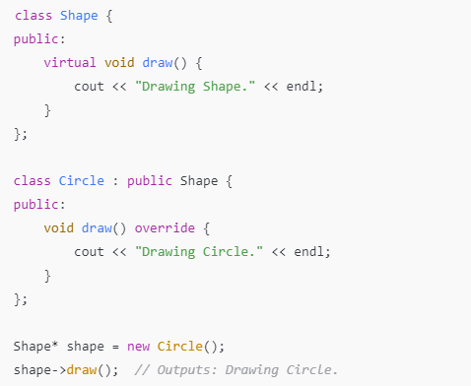
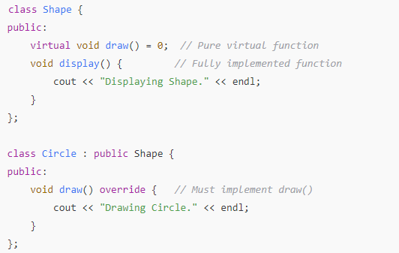
Abstract Class vs Virtual Function
Mandatory Override
Optional Override

Slide 13
Inheritance (Chapter 11) - Q12
In inheritance, how can the derived class access private members of the base class?
A) Through public functions of the base class
B) Directly, since it inherits everything
C) Through the use of a friend function
D) Both A and C

